Slide 1

Cochise Linux User Group

Slide 2

Grub Repair

Slide 3
Grub
Grub is a boot loader for many Linux distributions which basically tells your system where it can find installed operating system(s) on one or more hard drives. Your PC needs this information in order to boot into your Linux distribution successfully.

Slide 4
Grub Files
The Grub files on your system can be found in /boot/grub. This directory contains the Grub config file (grub.cfg) along with other files that are essential for Grub to find and boot into your operating system(s).

Slide 5
Grub Files
If one of these files gets deleted or otherwise edited to prevent Grub from doing its job, you will find yourself at the Grub Prompt (grub>) the next time you restart your computer. Other times, fiddling with partitions in a dual boot environment can cause similar issues. Either way, you end up needing to repair Grub.

Slide 6
Grub
So when powering on your PC, Grub begins to look for installed operating systems. If it has trouble finding one or if it can't load part of its config, you'll be brought to the Grub command line interface that allows you to repair the boot loader.
grub>

Slide 7
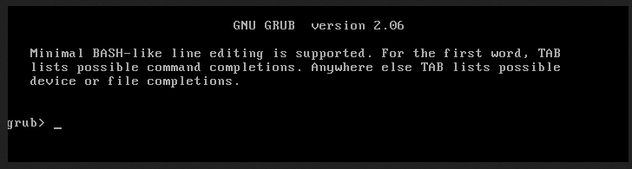
The Grub Prompt

Slide 8
Repairing The Grub Files
When you get to a grub> prompt, you can use the following commands as an attempt to fix your boot loader and get booted back into your Linux distribution.
Start by doing a simple ls command to see what partitions are available. Depending on your configuration, you may see multiple hard drives or partitions in this listing.

Slide 9
Repairing the Grub Files
If you have one hard drive and one operating system installed (like the great majority of users) the output of the ls command may look something like this:
  grub> ls
  (hd0) (hd0,gpt1) (hd0,gpt2)
  grub>

Slide 10
Repairing The Grub Files
With more than one hard drive the output may look like this:
  grub> ls
  (hd0) (hd1) (hd0,gpt1) (hd0,gpt2) (hd1,gpt1) (hd,gpt2)
  grub>

Slide 11
Repairing The Grub Files
You can see the files of any partition by using another ls command. This will help you identify which partition contains the Linux file system.
  ls (hd0,1)
  ls (hd0,2)

Slide 12
Repairing The Grub Files
The partition that you are looking for is the one that contains the Linux file system (and the Grub files).

Slide 13
Repairing The Grub Files
Once you have determined the correct partition, you can set it as root with the following commands.
For our example; we will be using (hd0,2) as our root partition, /boot/vmlinuz-6.2.0-20-generic as our Linux kernel, /boot/initrd.img-6.2.0-20-generic as our image file, and /dev/sda2 as our device name.
(Depending on your distribution and configuration, these values may be different for you. Use tab completion to help select the right Linux kernel and image file, and fdisk -l command to get the correct device name.

Slide 14
Repairing The Grub Files
To get the computer to boot, we need to tell it which partition holds the boot files.
grub> set root=(hd0,gpt2)

Slide 15
Repairing The GRUB Files
We need to specify which Linux kernel to boot from.
We do this with the Linux command
We also have to provide the root directory using the usual Linux hard drive and partitioning naming scheme.
grub> linux /boot/vmlinuz-6.2.0.20-generic root=/dev/sda2

Slide 16
Repairing The Grub Files
We also need to specify which RAM-based file system image to use when the system boots.
This must be the same numerical component as the Linux kernel we are using.
grub> initrd /boot/initrd.img-6.2.0.20-generic

Slide 17
Repairing The Grub Files
grub> set root=(hd0,gpt2)
grub> linux /boot/vmlinuz-6.2.0.20-generic root=/dev/sda2
grub> initrd /boot/initrd.img-6.2.0.20-generic

Slide 18
Repairing The Grub Files
Once you have set the root partition, Linux kernel, and initrd image file, you should be able to successfully boot into your Linux distro.
grub> boot
Once into the system you need to fix the Grub files so you do not have to do this at each reboot.

Slide 19
Repairing The Grub Files
Open a terminal and type:
sudo update-grub
  Very rarely you may have to re-install Grub using the command:
  sudo grub-install /dev/sda
  Replacing sda with the drive that Linux is installed on

Slide 20
Repairing The Grub Files
These actions should fix the problem with Grub.

Slide 21
The grub rescue> Prompt
Occasionally you will get a different prompt called the grub rescue> prompt

Slide 22
The grub rescue> Prompt

Slide 23
The grub rescue> Prompt

Slide 24
The grub rescue> Prompt
The commands we need to issue in this shell are a bit different.
We still use the ls command to find the Linux partition just as we did with the grub> prompt
Once that is identified, we can proceed with the following commands.

Slide 25
The grub rescue> Prompt
grub rescue> set prefix=(hd0,2)/boot/grub
Where hd0 partition 2 is where the Linux system is installed.
Use the drive identifiers that are correct for your computer

Slide 26
The grub rescue> Prompt
grub rescue> set root=(hd0,2)
Where hd0 partition 2 is where the Linux system is installed.
Use the drive identifiers that are correct for your computer

Slide 27
The grub rescue> Prompt
grub rescue> insmod normal
The insmod command loads the kernel modules

Slide 28
The grub rescue> Prompt
grub rescue> insmod linux

Slide 29
The grub rescue> Prompt
grub rescue> linux /boot/vmlinux-6.2.0.20-generic root=/dev/sda2
Use the drive identifiers and kernel version numbers that are correct for your computer

Slide 30
The grub rescue> Prompt
grub rescue> initrd /boot/initrd.img-6.2.0-20-generic

Slide 31
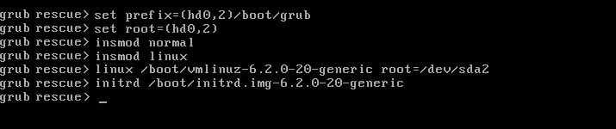
The grub rescue> Prompt

Slide 32
The grub rescue> Prompt
Type boot and hit enter.
Once the computer has rebooted and you have logged in, update Grub with the update-grub command so you don’t have to do this each time you start your computer.

Slide 33
Cochise Linux User Group

